Slide 1
Data Structures and Algorithms
Data Structures and Algorithms
Lecture 6 – Hashing
Miao Zhang

Slide 2
Search catagory
Static search
  Sequential Search
  Binary search
  Block search
Dynamic search
Hash search

Slide 3
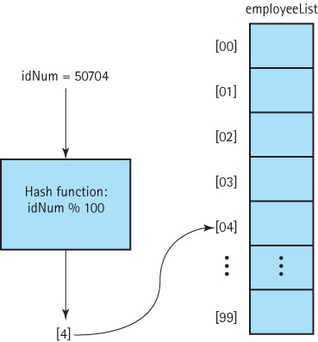
Hashing
Hashing: The process of mapping a key value to a position in a table.
A hash table is an array that holds the records. It is denoted by HT
A hash function maps key values to positions. It is denoted by h.

Slide 4
Definitions
Hashing: The technique for ordering and accessing elements in a list in a relatively constant amount of time by manipulating the key to identify its location in the list
Hash Functions: A function used to manipulate the key of an element in a list to identify its location in the list
Hash table: Term used to describe the data structure used to store and retrieve elements using hashing
The implementation of hash tables is called hashing.

Slide 5
Finding the hash function
How can we come up with this magic function?
In general, we cannot--there is no such magic function ☹
  In a few specific cases, where all the possible values are known in advance, it has been possible to compute a perfect hash function
What is the next best thing?
  A perfect hash function would tell us exactly where to look
  In general, the best we can do is a function that tells us where to start looking!

Slide 6
2 Situations When Designing Hash Functions
We know nothing about the distribution of the incoming keys.
  We wish to select a hash function that evenly distributes the key range across the hash table, while avoiding obvious opportunities for clustering such as hash functions that are sensitive to the high- or low-order bits of the key value.
We know something about the distribution of the incoming keys.
  We should use a distribution-dependent hash function that avoids assigning clusters of related key values to the same hash table slot.
    For example, if hashing English words, we should not hash on the value of the first character because this is likely to be unevenly distributed.

Slide 7
Properties of Good Hash Functions
Must return number 0, …, tablesize
Should be efficiently computable – O(1) time
Should not waste space unnecessarily
  For every index, there is at least one key that hashes to it
  Load factor lambda λ = (number of keys / TableSize)
Should minimize collisions
  = different keys hashing to same index

Slide 8
Some methods
Truncation:
  e.g. 123456789 map to a table of 1000 addresses by picking 3 digits of the key.
Folding:
  e.g. 123|456|789: add them and take mod.
Key mod N:
  N is the size of the table, better if it is prime.
Mid-Square:
  Square the key and then truncate
Radix conversion:
  e.g. 1 2 3 4 treat it to be base 11, truncate if necessary.

Slide 9
Hash Function (Truncation)
Truncation method
H(key) = a ×key ＋ b
Example:
{1548,1569,1527,1532,1505,1558,1547,1501}
Hash (1548)=48
Hash (1569)=69
Hash (1527)=27
Hash (1532)=32
Hash (1505)=05 ……

Slide 10
Hash function (Folding)
Folding method
    key = 381，412，975
    select 768 or 570 as the hash address.
381
412
975
1 768
975
214
381
1 570

Slide 11
Hash function (Key mod N)
Modulo method
H(key) = key % p , p < m；
Where p is a prime number, m is the size of the hash table
Remainder : 0 ～ p-1 .
Note: P being prime avoids a tendency to waste space

Slide 12
Hash Function (Mid-Square)
Mid-Square method
Example :
（4731）² ＝ 223 82 361 ；
select 82 （m ＝100 ）

Slide 13
Hash function (Radix conversion)
Radix conversion method
  convert a number in one base (radix) to the equivalent number in another base
  Example：
  k=(345)₁₀ → (423)₉ % size of table

Slide 14
Example a Hash Table ?
The simplest kind of hash table is an array of records.
This example has 701 records.
[ 0 ]
[ 1 ]
[ 2 ]
[ 3 ]
[ 4 ]
[ 5 ]
[ 700]
. . .
An array of records

Slide 15
Example a Hash Table ?
[ 4 ]
Each record has a special field, called its key.
In this example, the key is a long integer field called Number.
Number 506643548
[ 0 ]
[ 1 ]
[ 2 ]
[ 3 ]
[ 4 ]
[ 5 ]
[ 700]
. . .

Slide 16

Example a Hash Table ?
[ 4 ]
The number might be a person's identification number, and the rest of the record has information about the person.
Number 506643548
[ 0 ]
[ 1 ]
[ 2 ]
[ 3 ]
[ 4 ]
[ 5 ]
[ 700]
. . .

Slide 17



Example a Hash Table ?
When a hash table is in use, some spots contain valid records, and other spots are "empty".
[ 0 ]
[ 1 ]
[ 2 ]
[ 3 ]
[ 4 ]
[ 5 ]
[ 700]
Number 281942902
Number 233667136
Number 506643548
. . .
Number 155778322

Slide 18
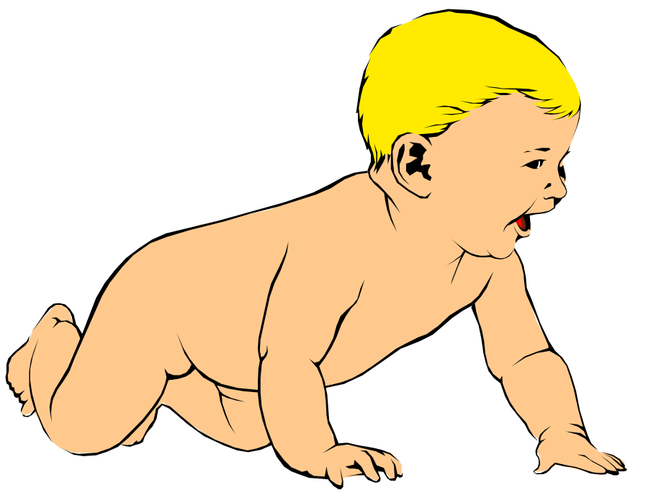
Inserting a New Record
In order to insert a new record, the key must somehow be converted to an array index by a hash function.
The index is called the hash value of the key.
Number 580625685
[ 0 ]
[ 1 ]
[ 2 ]
[ 3 ]
[ 4 ]
[ 5 ]
[ 700]
Number 281942902
Number 233667136
Number 506643548
. . .
Number 155778322

Slide 19
Inserting a New Record
Number 580625685
Typical way create a hash value:
(Number mod 701)
What is (580625685 mod 701) ?
[ 0 ]
[ 1 ]
[ 2 ]
[ 3 ]
[ 4 ]
[ 5 ]
[ 700]
Number 281942902
Number 233667136
Number 506643548
. . .
Number 155778322

Slide 20
Inserting a New Record
Number 580625685
Typical way to create a hash value:
(Number mod 701)
3
What is (580625685 mod 701) ?
[ 0 ]
[ 1 ]
[ 2 ]
[ 3 ]
[ 4 ]
[ 5 ]
[ 700]
Number 281942902
Number 233667136
Number 506643548
. . .
Number 155778322

Slide 21
Inserting a New Record
Number 580625685
The hash value is used for the location of the new record.
[3]
[ 0 ]
[ 1 ]
[ 2 ]
[ 3 ]
[ 4 ]
[ 5 ]
[ 700]
Number 281942902
Number 233667136
Number 506643548
. . .
Number 155778322

Slide 22
Inserting a New Record
The hash value is used for the location of the new record.
[ 0 ]
[ 1 ]
[ 2 ]
[ 3 ]
[ 4 ]
[ 5 ]
[ 700]
Number 281942902
Number 233667136
Number 580625685
Number 506643548
. . .
Number 155778322

Slide 23

Collisions
Number 701466868
Here is another new record to insert, with a hash value of 2.
My hash
value is [2].
[ 0 ]
[ 1 ]
[ 2 ]
[ 3 ]
[ 4 ]
[ 5 ]
[ 700]
Number 281942902
Number 233667136
Number 580625685
Number 506643548
. . .
Number 155778322

Slide 24

Collisions
This is called a collision, because there is already another valid record at [2].
Number 701466868
When a collision occurs,
move forward until you
find an empty spot.
[ 0 ]
[ 1 ]
[ 2 ]
[ 3 ]
[ 4 ]
[ 5 ]
[ 700]
Number 281942902
Number 233667136
Number 580625685
Number 506643548
. . .
Number 155778322

Slide 25
Collisions
When two values hash to the same array location, this is called a collision
Collisions are normally treated as “first come, first served”—the first value that hashes to the location gets it
We have to find something to do with the second and subsequent values that hash to this same location

Slide 26
Collision Resolution
If, when an element is inserted, it hashes to the same value as an already inserted element, then we have a collision and need to resolve it.
There are several methods for dealing with this:
  Open Hashing (Separate chaining)
  Closed Hashing (Open addressing)
    Linear Probing
    Quadratic Probing
    Double Hashing
  Bucket Hashing

Slide 27
Separate Chaining
The idea is to keep a list of all elements that hash to the same value.
  The array elements are pointers to the first nodes of the lists.
  A new item is inserted to the front of the list.
Advantages:
  Better space utilization for large items.
  Simple collision handling: searching linked list.
  Overflow: we can store more items than the hash table size.
  Deletion is quick and easy: deletion from the linked list.

Slide 28
Example
Keys: 0, 1, 4, 9, 16, 25, 36, 49, 64, 81
hash(key) = key % 10.
0
0
1
81
1
2
3
4
64
4
5
25
6
36
16
7
8
9
49
9

Slide 29
Operations
Initialization: all entries are set to NULL
Find:
  locate the cell using hash function.
  sequential search on the linked list in that cell.
Insertion:
  Locate the cell using hash function.
  (If the item does not exist) insert it as the first item in the list.
Deletion:
  Locate the cell using hash function.
  Delete the item from the linked list.

Slide 30
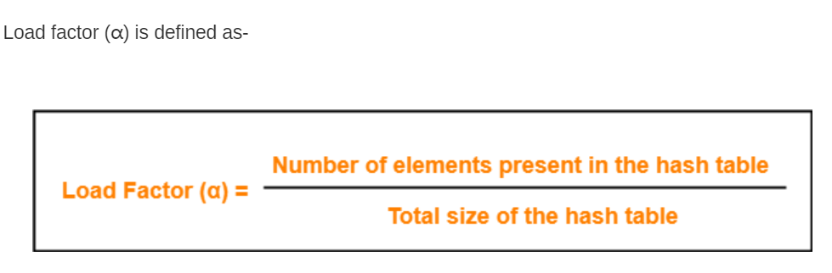
Collision Resolution with
Open Addressing
Separate chaining has the disadvantage of using linked lists.
  Requires the implementation of a second data structure.
In an open addressing hashing system, all the data go inside the table.
  Thus, a bigger table is needed.
    Generally the load factor should be below 0.5.
  If a collision occurs, alternative cells are tried until an empty cell is found.

Slide 31
Open Addressing
More formally:
  Cells h₀(x), h₁(x), h₂(x), …are tried in succession where h_{i}(x) = (hash(x) + f(i)) mod TableSize, with f(0) = 0.
  The function f is the collision resolution strategy.
There are three common collision resolution strategies:
  Linear Probing
  Quadratic probing
  Double hashing

Slide 32
Linear Probing
In linear probing, collisions are resolved by sequentially scanning an array (with wraparound) until an empty cell is found.
  i.e. f is a linear function of i, typically f(i)= i.
Example:
  Insert items with keys: 89, 18, 49, 58, 9 into an empty hash table.
  Table size is 10.
  Hash function is hash(x) = x mod 10.
    f(i) = i;

Slide 33
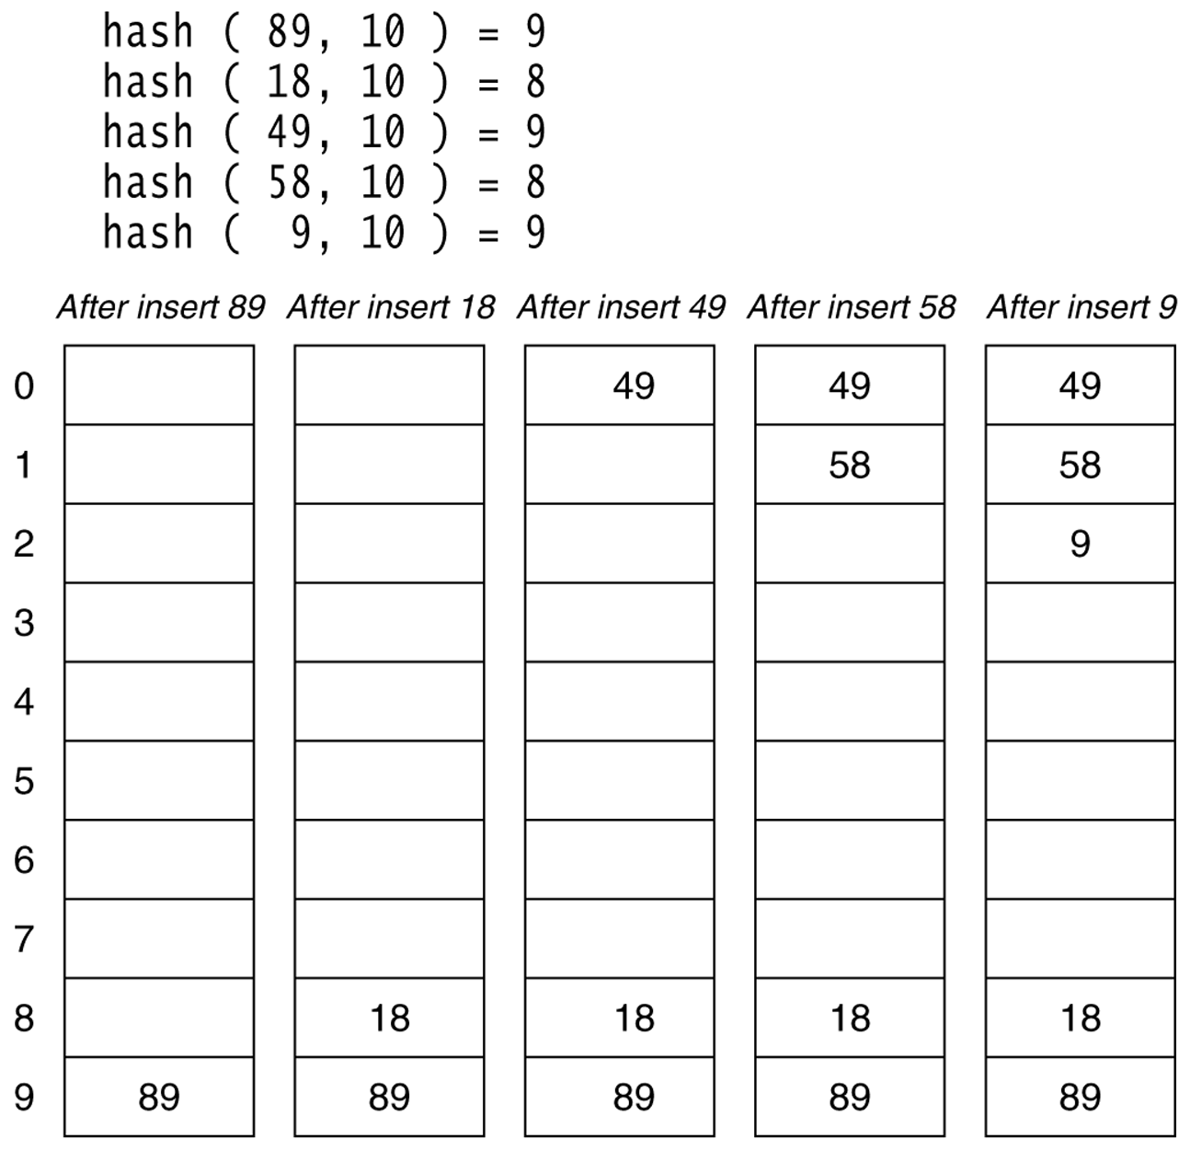
Linear Probing (example)
Linear probing hash table after each insertion

Slide 34
Clustering Problem
As long as table is big enough, a free cell can always be found, but the time to do so can get quite large.
Worse, even if the table is relatively empty, blocks of occupied cells start forming.
This effect is known as primary clustering.
Any key that hashes into the cluster will require several attempts to resolve the collision, and then it will add to the cluster.

Slide 35
Linear Probing – Analysis -- Example
What is the average number of probes for a successful search and an unsuccessful search for this hash table?
  Hash Function: h(x) = x mod 11
Successful Search:
  20: 9 -- 30: 8 -- 2 : 2 -- 13: 2, 3 -- 25: 3,4
  24: 2,3,4,5 -- 10: 10 -- 9: 9,10, 0
Avg. Probe for SS = (1+1+1+2+2+4+1+3)/8=15/8
Unsuccessful Search:
  We assume that the hash function uniformly distributes the keys.
  0: 0,1 -- 1: 1 -- 2: 2,3,4,5,6 -- 3: 3,4,5,6
  4: 4,5,6 -- 5: 5,6 -- 6: 6 -- 7: 7 -- 8: 8,9,10,0,1
  9: 9,10,0,1 -- 10: 10,0,1
Avg. Probe for US =
(2+1+5+4+3+2+1+1+5+4+3)/11=31/11
Probing times
0 | 9
1
2 | 2
3 | 13
4 | 25
5 | 24
6
7
8 | 30
9 | 20
10 | 10
3
1
2
2
4
1
1
1

Slide 36
Quadratic Probing
Quadratic Probing eliminates primary clustering problem of linear probing.
Collision function is quadratic.
  The popular choice is f(i) = i².
If the hash function evaluates to h and a search in cell h is inconclusive, we try cells h + 1², h+2², … h + i².
  i.e. It examines cells 1,4,9 and so on away from the original probe.
Remember that subsequent probe points are a quadratic number of positions from the original probe point.

Slide 37
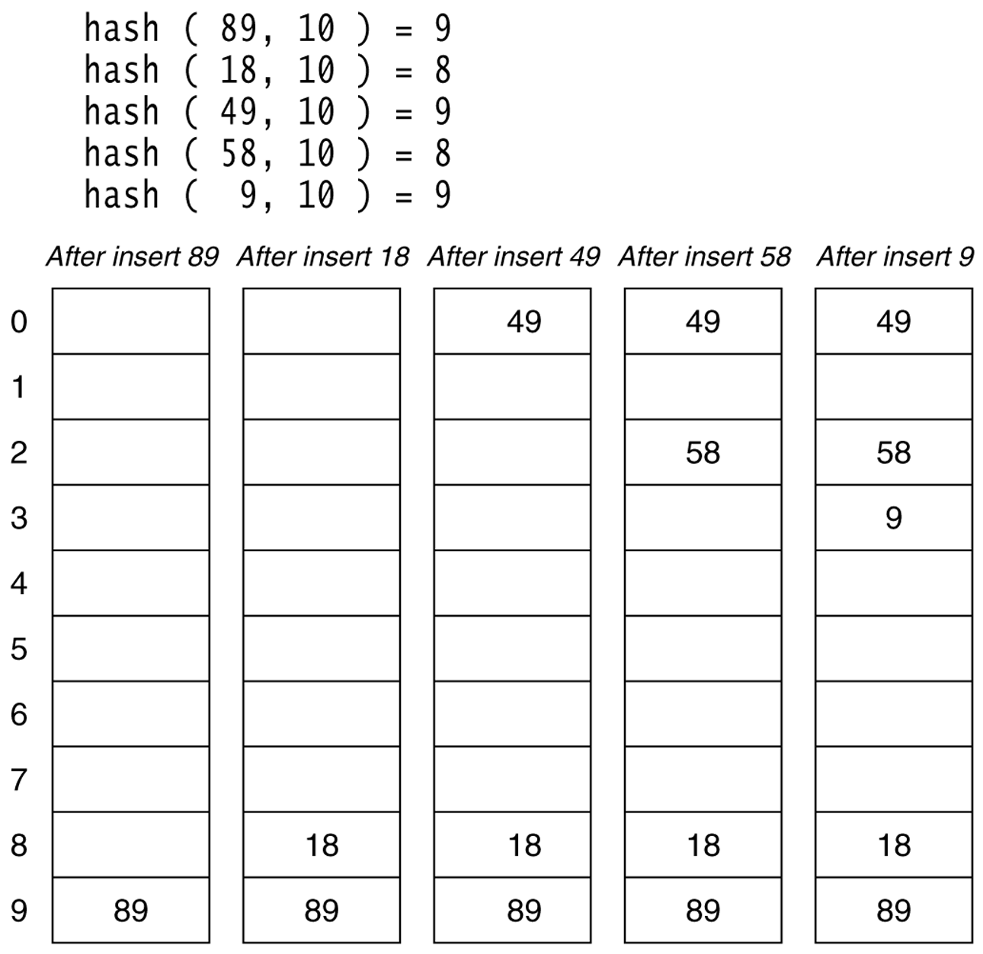
Quadratic Probing (example)
A quadratic probing hash table after each insertion (note that the table size was poorly chosen because it is not a prime number).

Slide 38
Quadratic Probing
Problem:
  We may not be sure that we will probe all locations in the table (i.e. there is no guarantee to find an empty cell if table is more than half full.)
  If the hash table size is not prime this problem will be much severe.
However, there is a theorem stating that:
  If the table size is prime and load factor is not larger than 0.5, all probes will be to different locations and an item can always be inserted.

Slide 39
Theorem
If quadratic probing is used, and the table size is prime, then a new element can always be inserted if the table is at least half empty.

Slide 40
Proof
Let M be the size of the table and it is prime. We show that the first ⎡M/2⎤ alternative locations are distinct.
Let two of these locations are h + i² and h + j², where i, j are two probes s.t. 0≤ i,j ≤ ⎣M/2⎦. Suppose for the sake of contradiction, that these two locations are the same but
i ≠ j. Then
h + i² = h + j² (mod M)
i² = j² (mod M)
i² - j² = 0 (mod M)
(i-j)(i+j) = 0 (mod M)
Because M is prime, either (i-j) or (i+j) is divisible by M. Neither of these possibilities can occur. Thus we obtain a contradiction.
It follows that the first ⎡M/2⎤ alternative are all distinct and since there are at most ⎣M/2⎦ items in the hash table it is guaranteed that an insertion must succeed if the table is at least half full.

Slide 41
Analysis of Quadratic Probing
Quadratic probing has not yet been mathematically analyzed.
Although quadratic probing eliminates primary clustering, elements that hash to the same location will probe the same alternative cells. This is know as secondary clustering.
Techniques that eliminate secondary clustering are available.
  the most popular is double hashing.

Slide 42
Double Hashing
Use a hash function for the decrement value
  Hash(key, i) = H₁(key) – (H₂(key) * i)
Now the decrement is a function of the key
  The slots visited by the hash function will vary even if the initial slot was the same
  Avoids clustering
Theoretically interesting, but in practice slower than quadratic probing, because of the need to evaluate a second hash function.

Slide 43
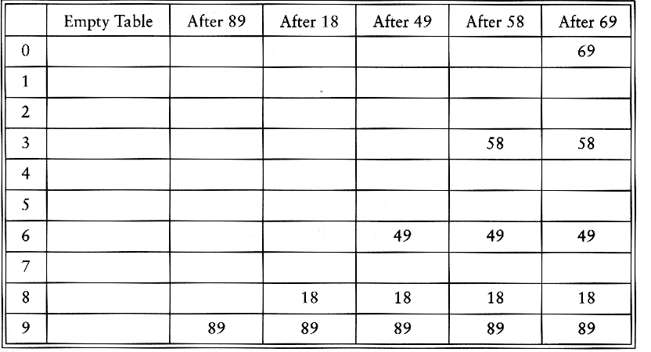
Double Hashing Example
h_{i}(K) = ( hash(K) + f(i) ) mod m; hash(K) = K mod m
f(i) = i * hash2(K); hash2(K) = R - (K mod R),
Example: m=10, R = 7 and insert keys 89, 18, 49, 58, 69
h_{i}(K) = ( hash(K) + i * hash2(K) ) mod m （i=0，1，2… m-1）
To insert 49, hash2(49)=7, 2nd probe is T[(9+7) mod 10]=6
To insert 58, hash2(58)=5, 2nd probe is T[(8+5) mod 10]=3
To insert 69, hash2(69)=1, 2nd probe is T[(9+1) mod 10]

Slide 44
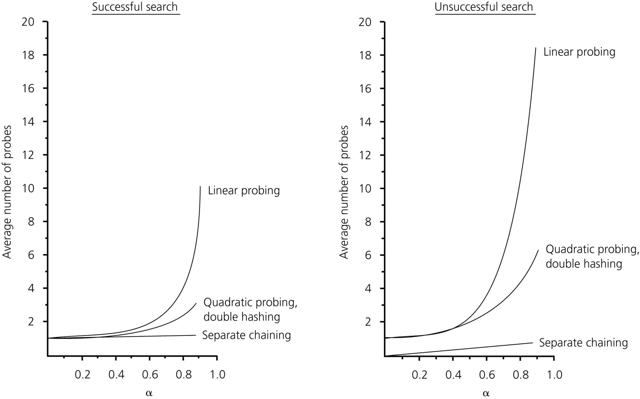
The relative efficiency of four collision-resolution methods

Slide 45
Applications
Keeping track of customer account information at a bank
  Search through records to check balances and perform transactions
Keep track of reservations on flights
  Search to find empty seats, cancel/modify reservations
Search engine
  Looks for all documents containing a given word

Slide 46
Summary
Hash tables can be used to implement the insert and find operations in constant average time.
  it depends on the load factor not on the number of items in the table.
It is important to have a prime TableSize and a correct choice of load factor and hash function.
For separate chaining the load factor should be close to 1.
For open addressing load factor should not exceed 0.5 unless this is completely unavoidable.
  Rehashing can be implemented to grow (or shrink) the table.

Slide 47
Exercises
Suppose hash table is HT[13], hash function h(key)=key%13. Utilize the closed hashing to solve the collisions. According to the keys to build a hash table. Keys: 12，23，45，57，20，03，78，31，15，36.
（1）Utilize a linear probing to make a hashing table. And calculate the ASL of successful searching and unsuccessful searching respectively.
（2）Utilize a re-hashing to find next address，a double hashing function is RH(key)=(7*key)%10+1，find next address by this expression
H_{i}=(H_{i-1}+RH(key))%13,H₁=RH(key). Draw the hash table, and calculate the ASL of successful search.

Slide 48
Homework
Please refer to Icourse.
Due date for quiz: 23:30 October 21, 2022
Due date for homework: 23:30 October 26, 2022
Due data for offline lab assignment: 23:30 October 26, 2022

